Slide 1


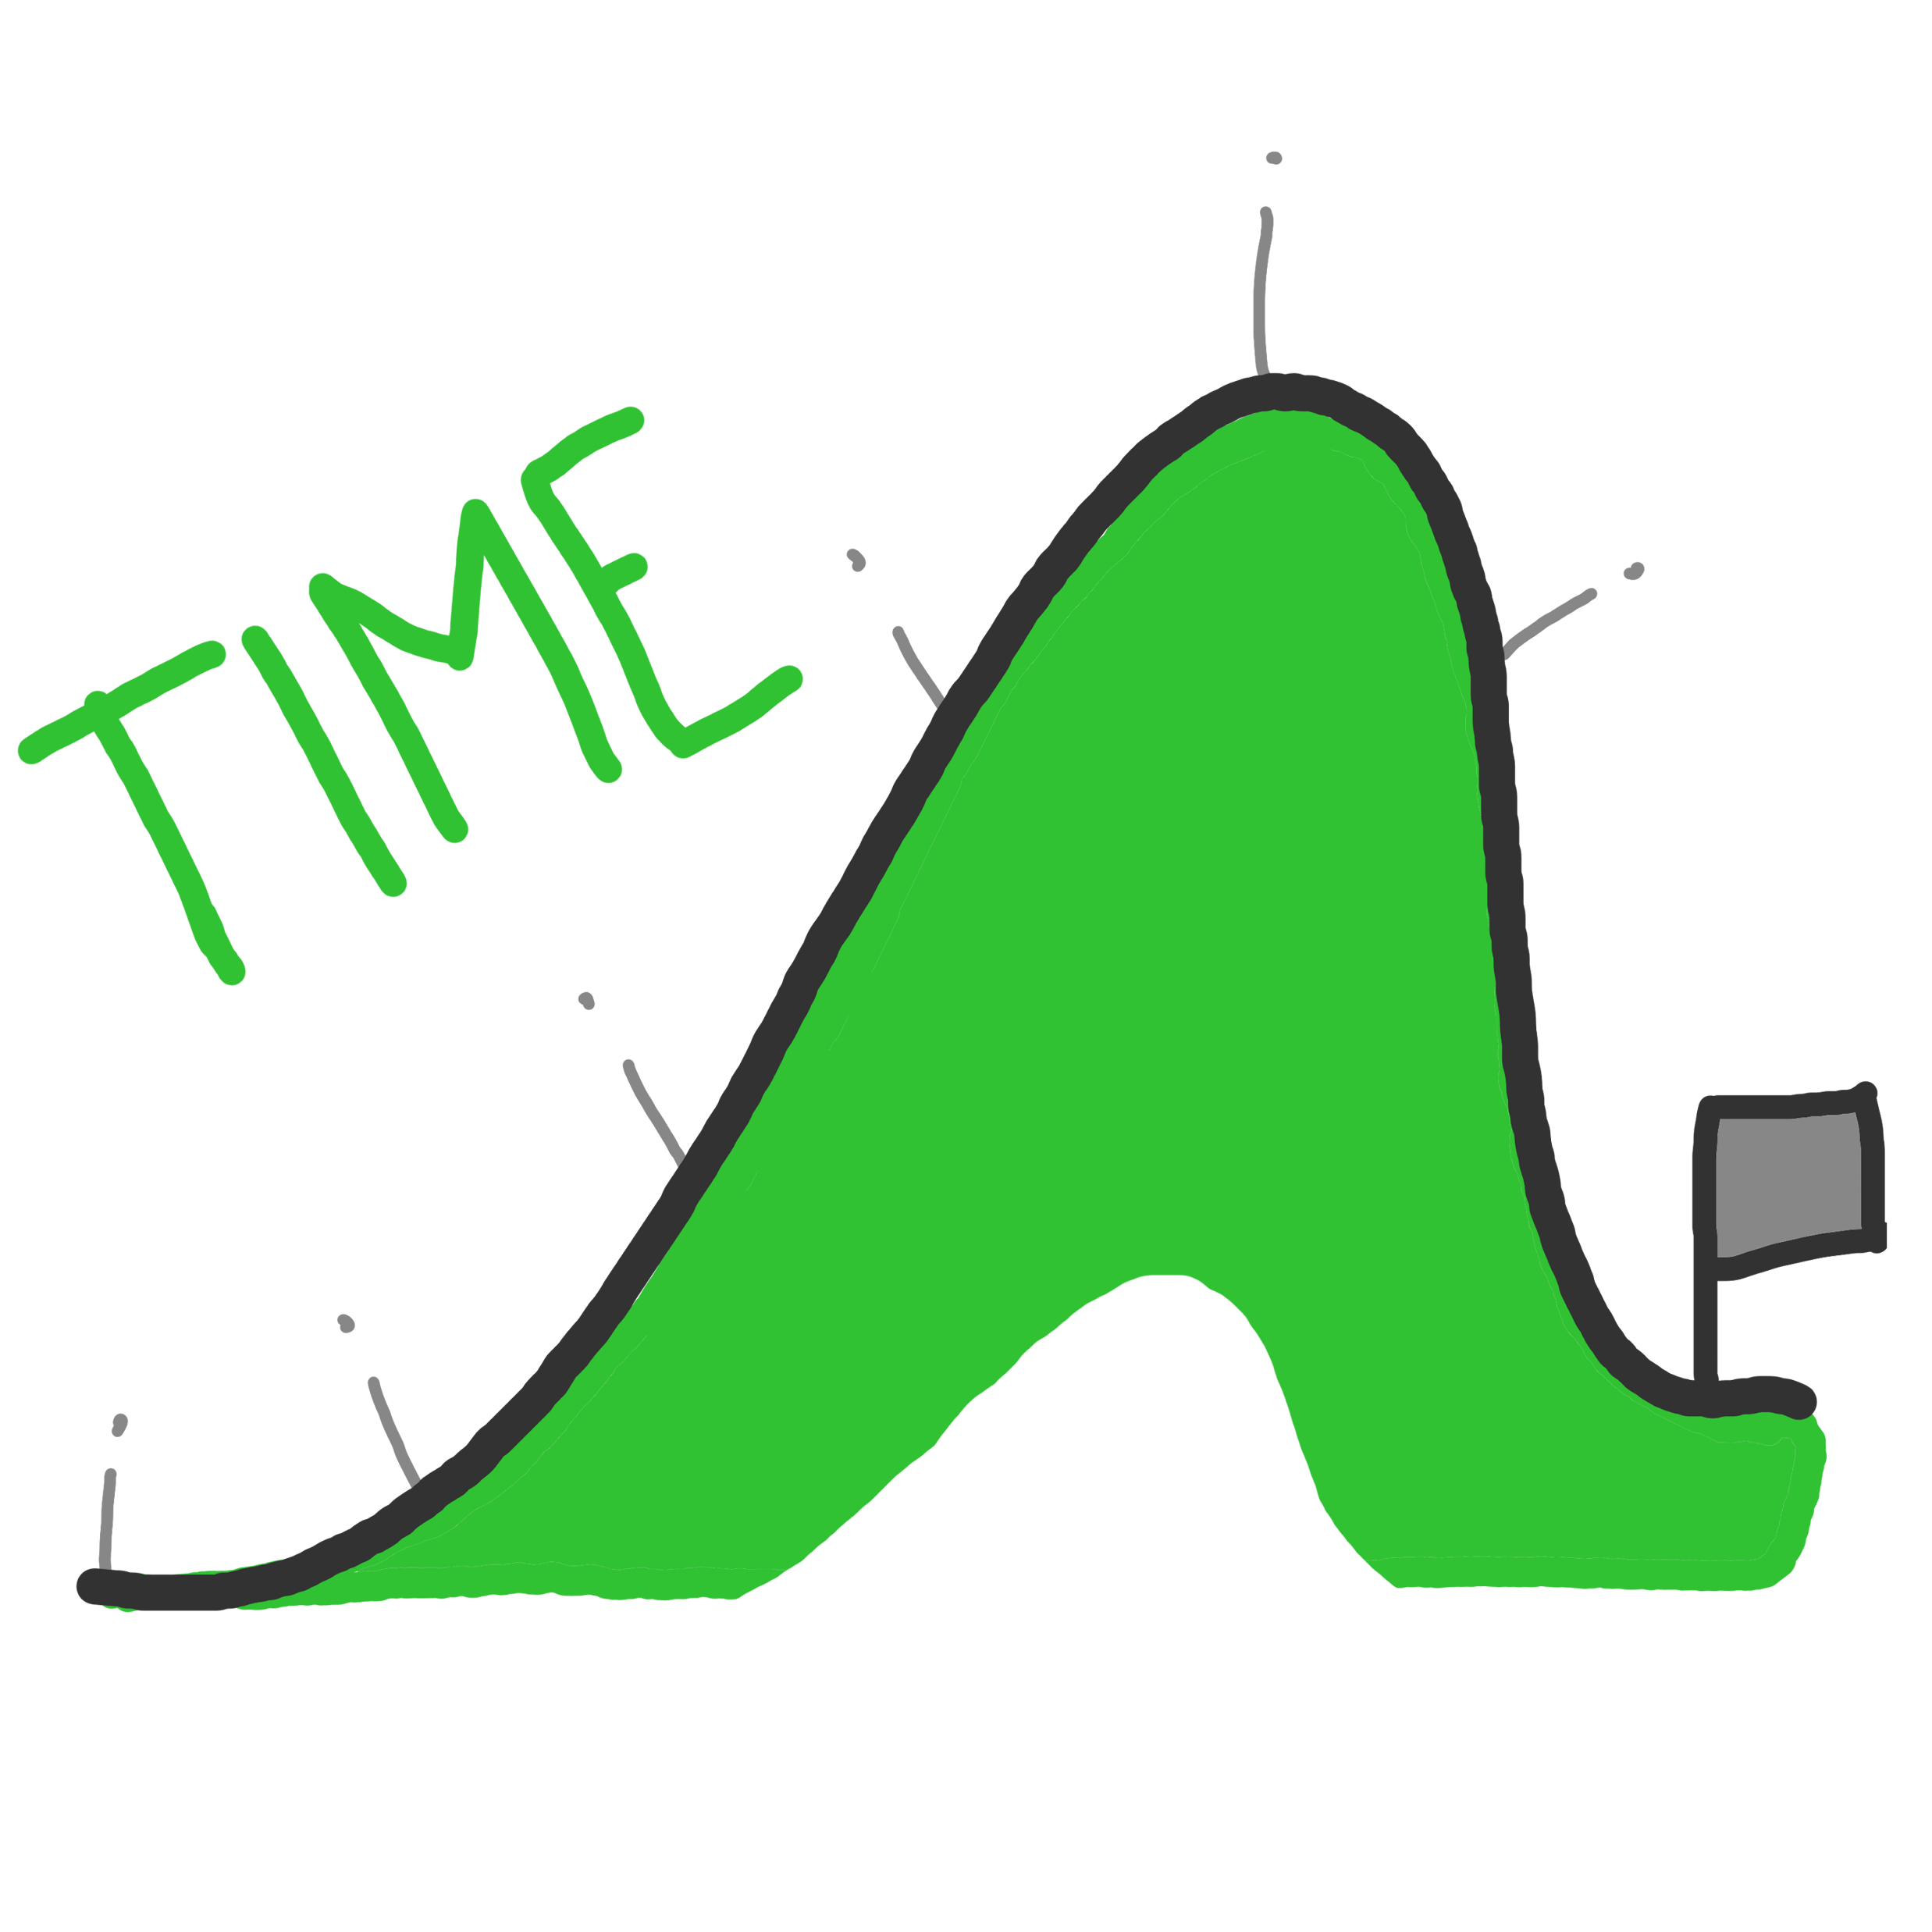
TIME

Slide 2
Order information chronologically: that is
in a straightforward time-sequence from oldest to most recent.
Content below: slides 5-16
Ideally, include all 12 content slides.

Slide 3

START =
3 years ago

Slide 4
END =
2 years in the future

Slide 5

Research Breakthrough= Complete Control Varying fluffino acid specifics enable control of beard hair strands to unparalleled level. Instant sculpture to desired shape.
Importance: ◻◻◻ | Patent confirmed 1 year ago

Slide 6
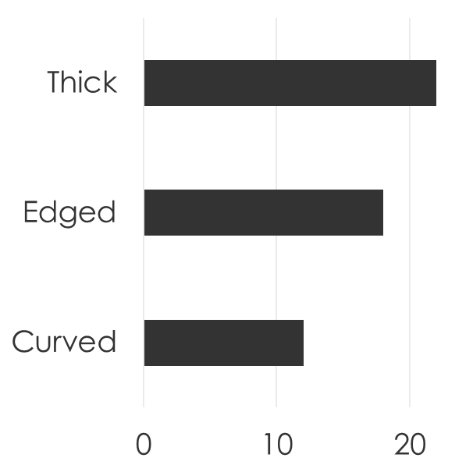
Research ½ of Men Crave Control Consumer research shows that 52% of men (with beards) say they wish they could get the beard shape they want every time.
Importance: ◻◻◻ | Research 18 months ago

Slide 7


Research Breakthrough= Thicker Beards Fluffino acids lead to thicker hair - both in terms of concentration of active follicles (+26%) and hair thickness (+31%) | ⬇
Importance: ◻ | Patent confirmed 2 years ago

Slide 8
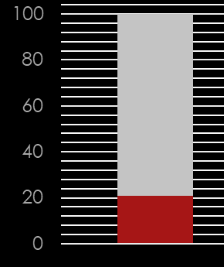
Research 1 in 5 Men Yearn for Thicker Beards 21 % of men confirm that they cannot grow a full beard (and are sad about this).
Importance:  | Research undertaken 6 months ago

Slide 9
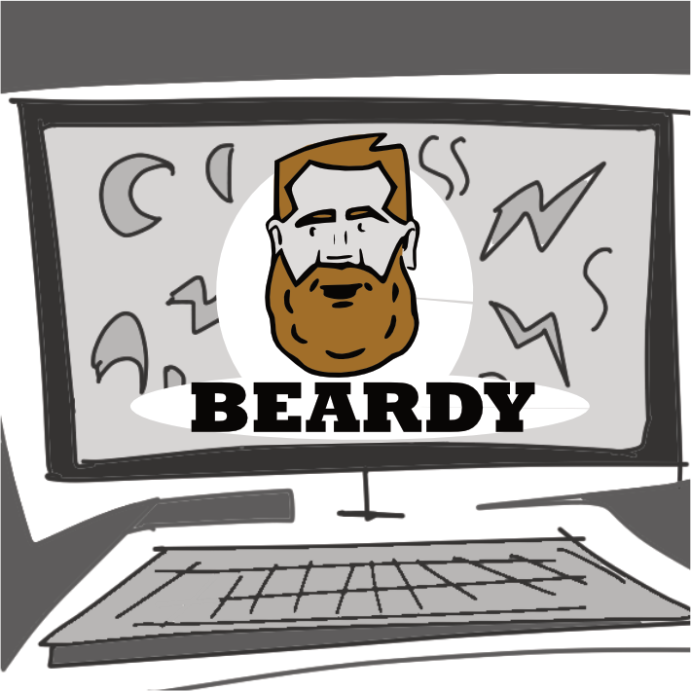
Marketing $5 million TV Ad Spend Great copy delivered through omni-channel advertising plan. BEARDY will be seen everywhere.
Importance: ◻ | For first 6 months of launch

Slide 10
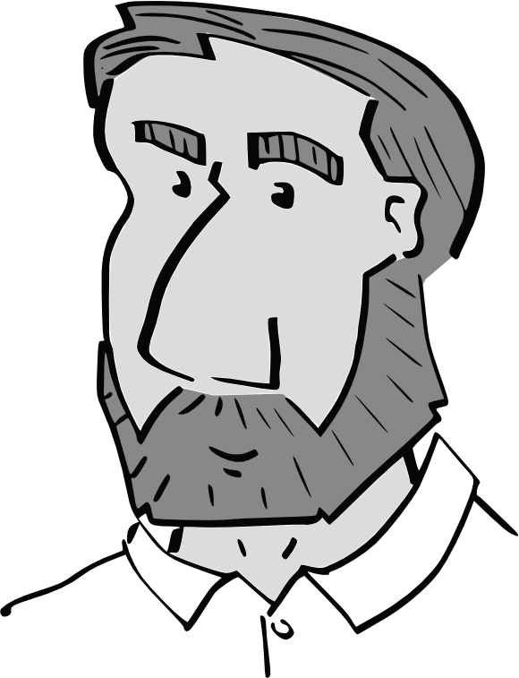
Marketing Summer Olympics = Volleyball Star Hugh Jumps (volleyball superstar) is lead endorser for BEARDY in all communications over Summer Olympics.
Importance: ◻◻◻ | Summer after launch

Slide 11
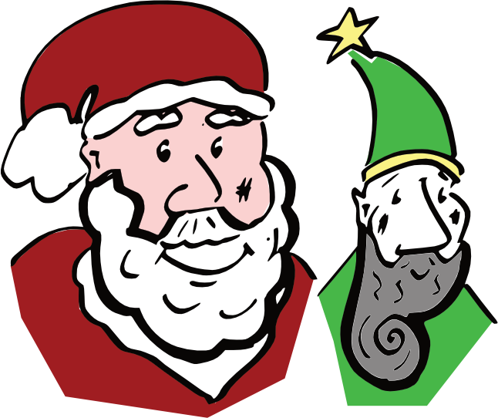
Marketing Winter Campaign = Santa + Elf Fun campaign will bring Santa and Elf characters together to drive awareness of variants Spiral and Thicket.
Importance: ◻◻◻◻ | Winter, post launch

Slide 12
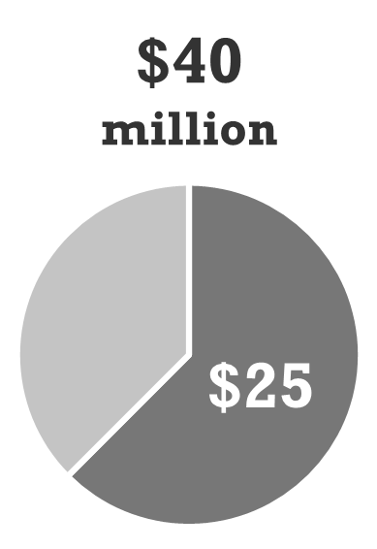
Sales $40 million sales [+$25 million] Target is $40 million sales of BEARDY in first 12 months. Expect $25 million to be new sales (increasing category value).
Importance: ◻◻ | 1 year after launch

Slide 13
Sales Category Sales Trending Down Sales of Hair Care products have fallen 10% from last 3 years ago. | Year -3 = - 2% Year -2 = - 3% Last Year = - 5%
Importance:  | National sales, last 3-years

Slide 14

Launch Recommended Price = $6.00 Price that is great for the consumer. Price that is margin enhancing for the trade. | $6.00 (RRP)
Importance: ◻◻◻◻ | At launch

Slide 15

Launch 3 Variants ‘Thicket’ for fulsome shape; ‘Wedge’ for strong angles ‘Spiral’ for all curves
Importance: ◻◻ | At launch

Slide 16

Launch 1/3rd Off Launch Promotion In-store promotions across the trade. $4.00 promotion price (vs RRP of $6.00)
Importance: ◻◻◻◻ | Month 2 of launch

