Slide 1
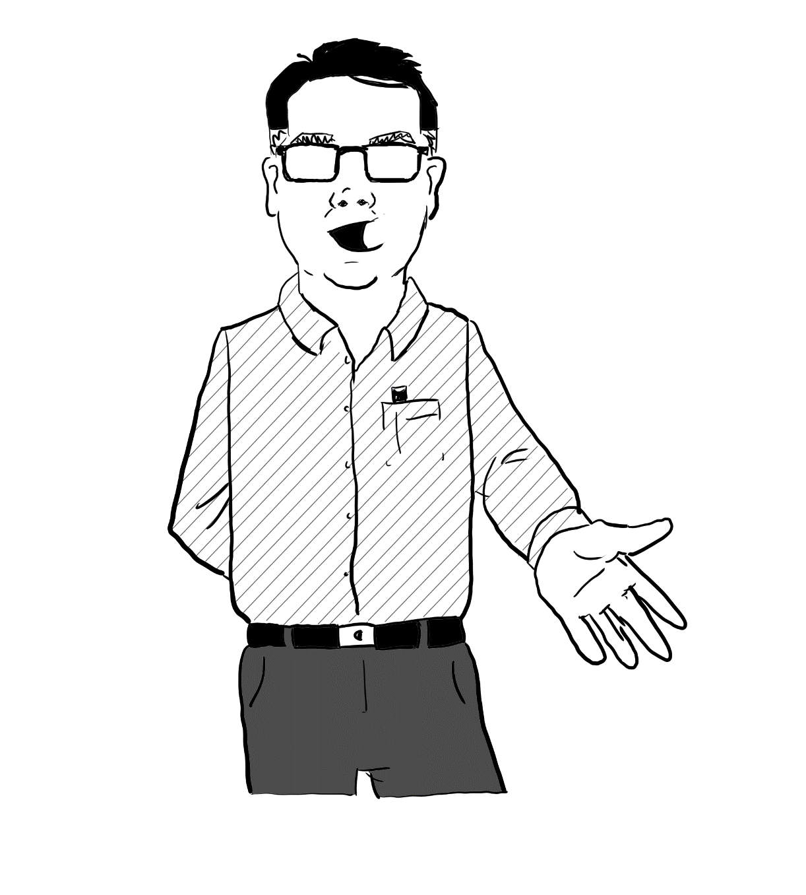
Virtual Facilitator
Useful Slides

Slide 2






Cursor
Disappearing Ink
Pen
Text
Cursor
Clear
Notes:
NEW WEBEX

Slide 3


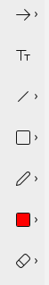
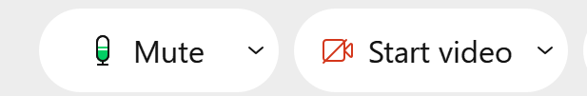


Notes:
OLD WEBEX

Slide 4
1. In MS Teams trainer enables annotations
2. Annotation bar appears on top of your screen
Write text
Draw
Erase

Slide 5
Take a Seat
Notes:
Set a sense of a small classroom.
Seat at the front for the facilitator. Seat at the back for the Producer.

Slide 6
Take a Seat
Notes:
Set a sense of a small classroom.
Seat at the front for the facilitator. Seat at the back for the Producer.

Slide 7
Take a Seat
B
Producer
A
C
D
Notes:
Alternative if you want ongoing Cabaret style

Slide 8

Where are we?
Notes:
Where in the World. Just move/resize the top image to frame the part of the world connecting in.

Slide 9
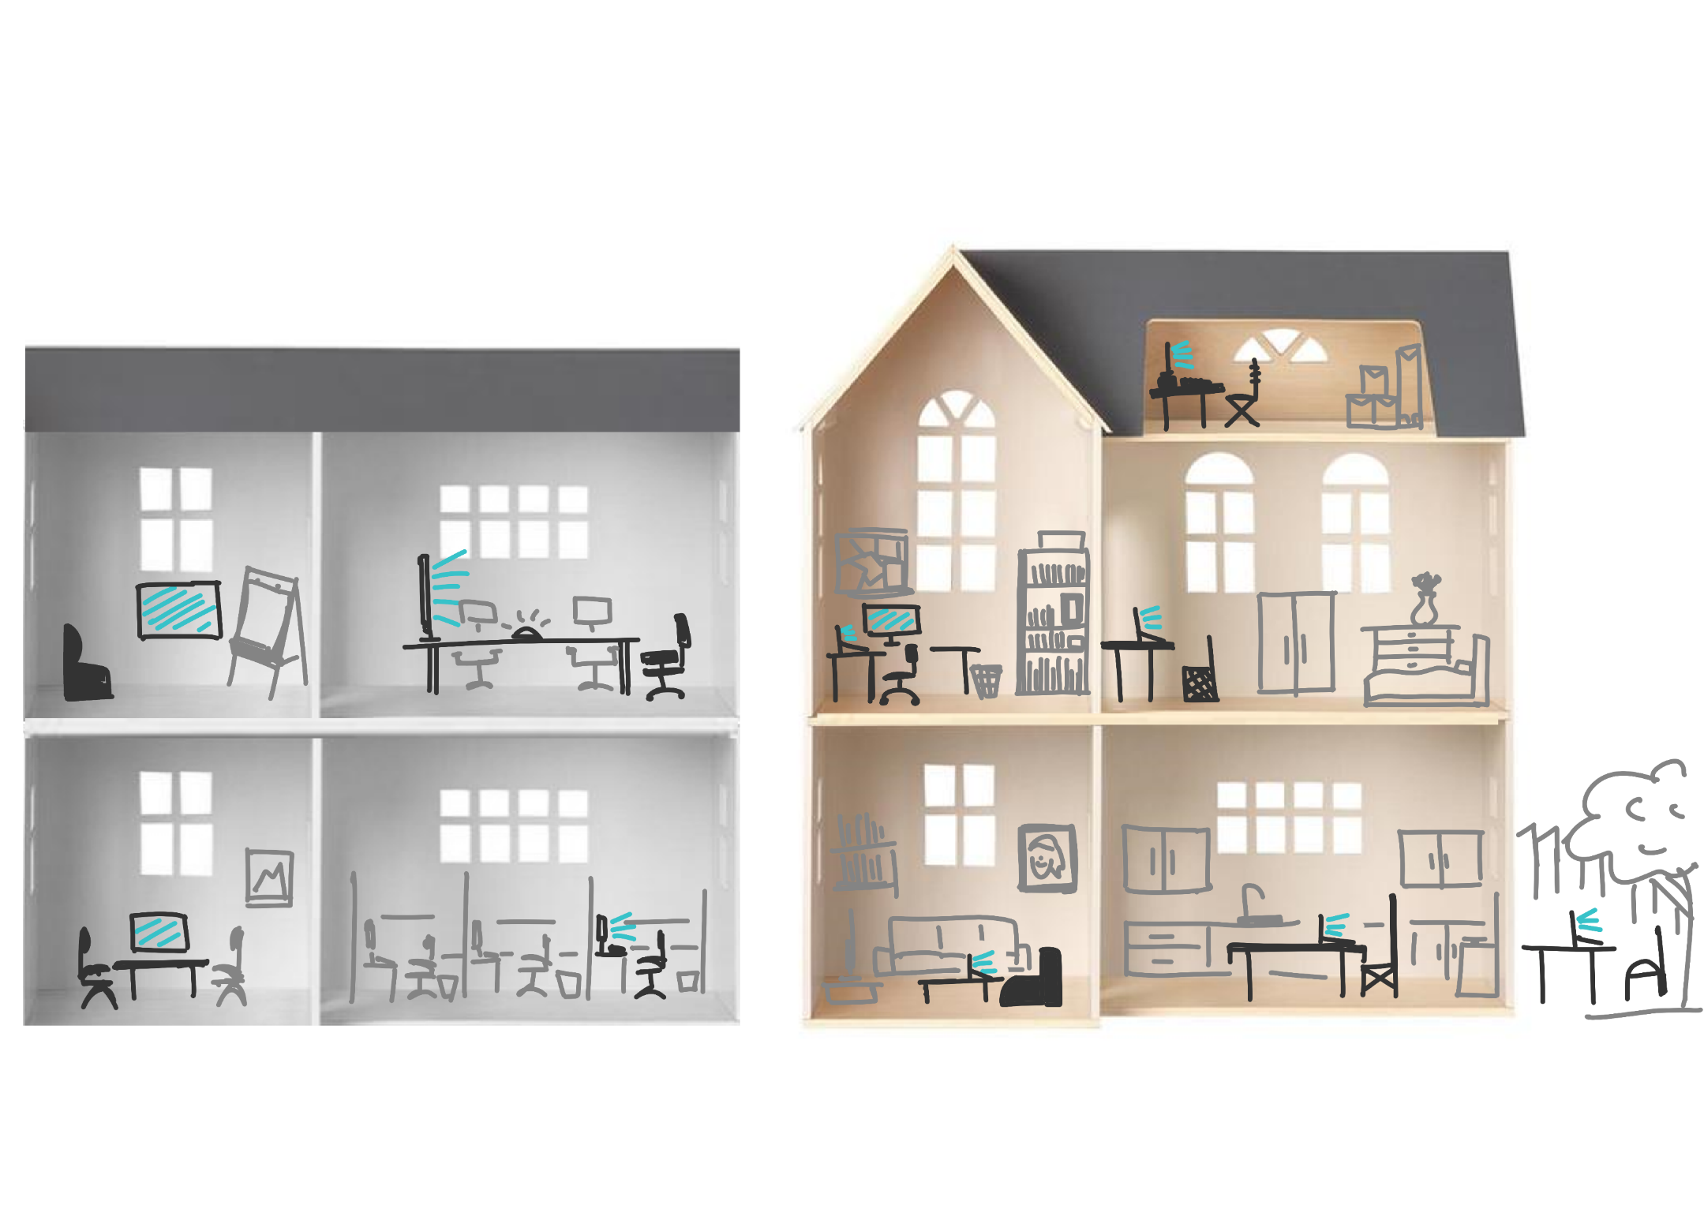
Stamp the room that best fits yours:
HOME
OFFICE

Slide 10

What makes a great
“Real Life” Classroom Environment?
Name

Slide 11


Slide 12


Slide 13


Slide 14

Question text text text text text?
Notes:
Pinboard for ideas-board.
Attendees write up their responses to a question or task.

Slide 15
I’ve seen it all before
Give me more
I’m with you
I’m struggling
I’m Lost

Slide 16


Exercise
Prepare a Virtual
Environment
Group: Break-Out Groups – Lea Ann will split us.
Activity: How do we replicate these in Virtual Classrooms?
Notes: page 5.
Output: Volunteer – be ready to
summarise for your group.
Notes:
Exercise Slide.
Include:
Distinct look for “Exercise/activity”.
Instructions and diagram for grouping.
Clear articulation of the activity.
Reference to further info
Output – what they will expected to do, be ready to do, at the end.

Slide 17
Chat
Prepare a Virtual
Environment
Group: Total Class – through Chat
Activity: Questions on shared so far.
Output: Richard answers.

Slide 18
Questions?
Prepare a Virtual
Environment
Group: Volunteer– through Chat
Activity: Write down questions on what to ask.
Output: Richard answers.

Slide 19
Exercise
Group: Pairs – work with the person next to you.
Activity: Discuss your key “Aha’s”
Define 2x Residual Questions
Notes: page 13.
Output: “Aha’s” noted in your Handbook.
Residual Questions put into Chatroom.
Taking it FORWARD→

Slide 20
Exercise
Group: Individually – work in your Handbook
Activity: Answer the questions
Notes: page 13.
Output: Personal conclusions, commitments, and a plan for what next.
Taking it FORWARD→

Slide 21
INTERVIEW

Slide 22

Notes:
Maybe you want to follow a “monopoly” style journey.

Slide 23



Notes:
Or maybe it is a wavy journey your are going on.

Slide 24
P&G Sales Process
P. S. F.
Persuasive | Selling | Format
1.
Summarise the Situation
2.
State the Idea
3.
Explain How it Works
4.
Reinforce the Key Benefits
5.
Easy Next Step
Conditions
Needs
Limitations
Opportunities
Features & Benefits
Notes:
Or something more linear.

Slide 25


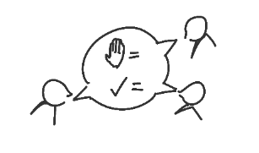
DURING
Campfire
Start Together
Define a Language
Notes:
An example of a chapter with sub-chapters slide (one highlighted).
Left area open for sub-content to be added.

Slide 26
A
B
C
Patience
Notes:
Another example of sub-content structure.

Slide 27

Thank You
www.makingpresentations.co.uk
richard.pascoe@makingpresentations.co.uk

